Slide 1
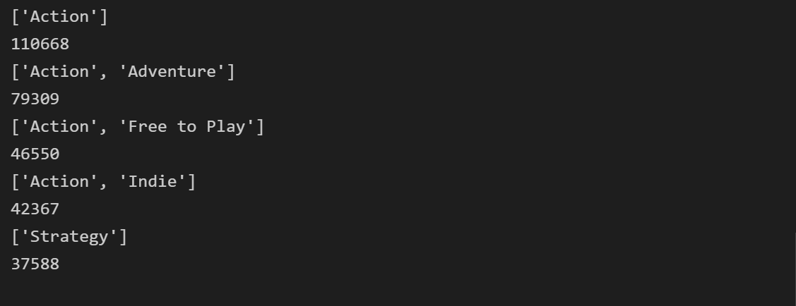

Slide 2
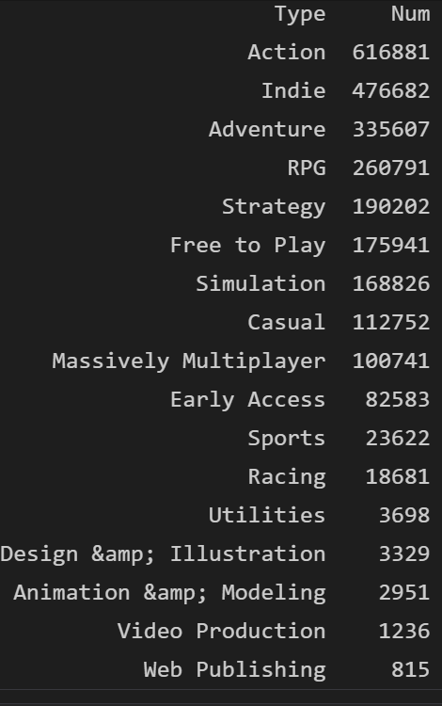

Slide 3
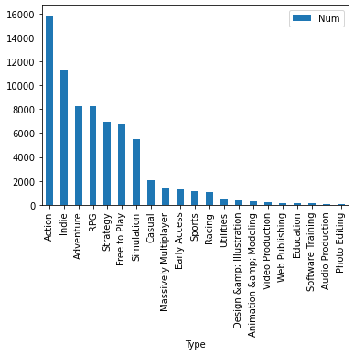
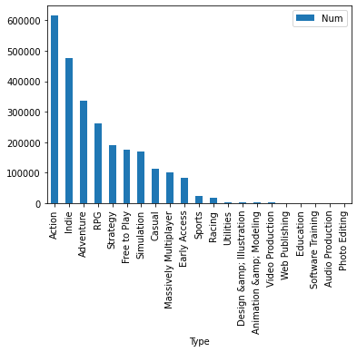

Slide 4
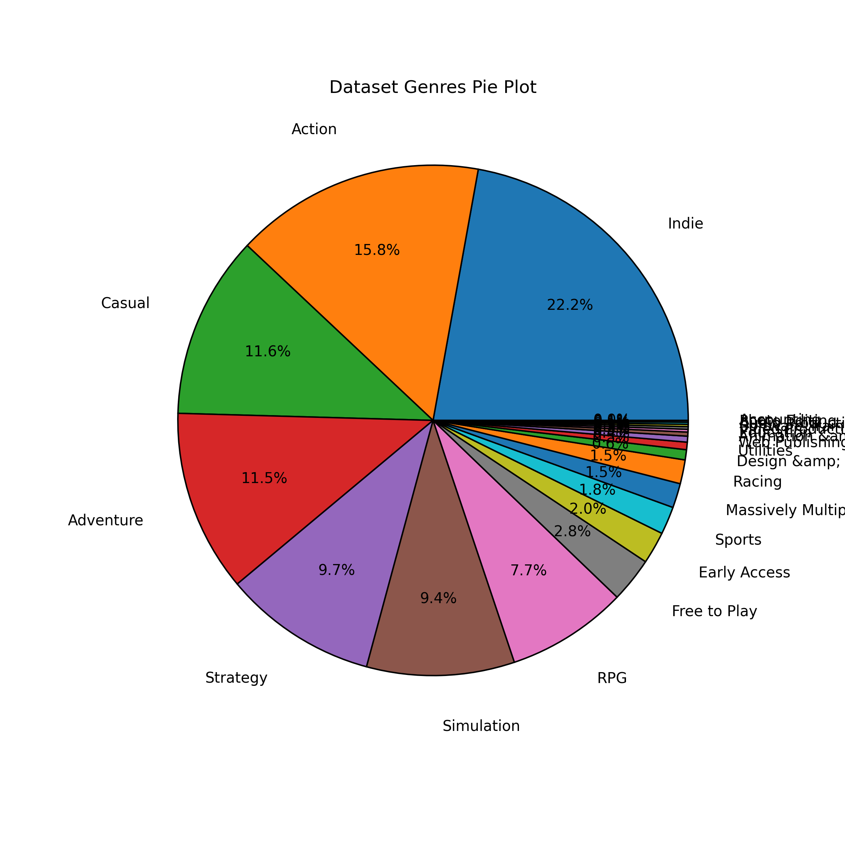
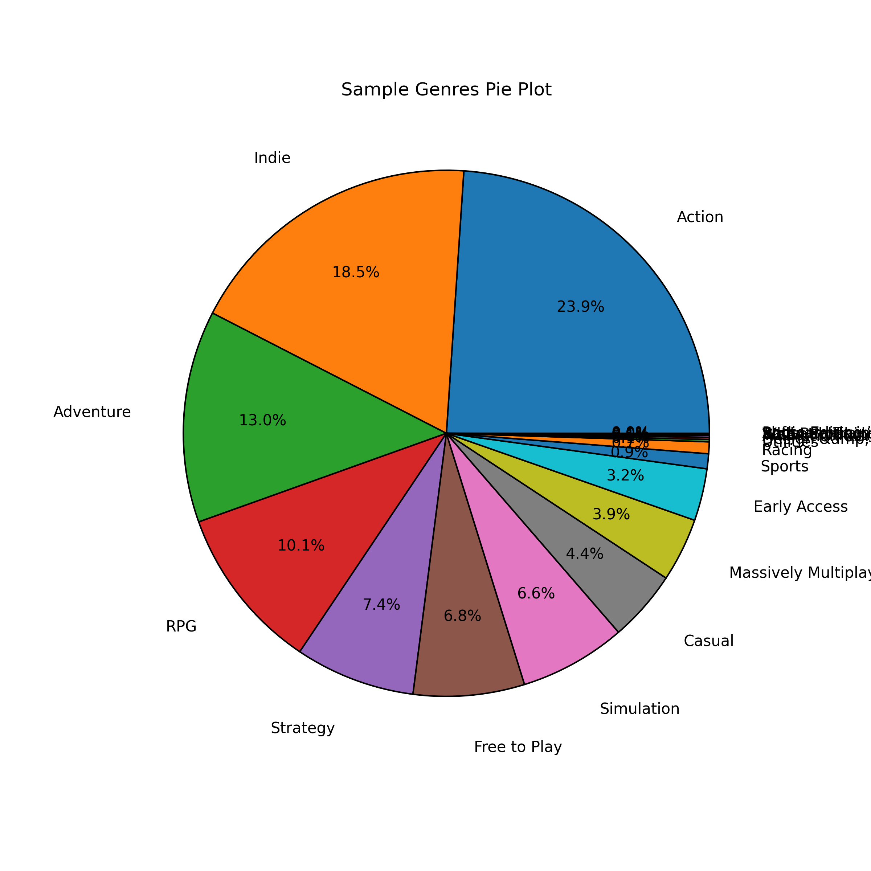

Slide 5


Slide 6
Data Cleaning
Drop na
Drop_duplicates
Drop if not string
Replace only number and misspelling(dropna again)
Convert lowercase if it is a word(normalization)

